Slide 1

Professional Practice & Employability
Group 2 Team 6 – Company Asset Tracking System
30001575 – Jack Davies
30014005 – Chloe Andronicou
30002739 - Jenni Wewhell
30007730 - Saidhbh O’malley
18077552 - Brendon Plummer

Slide 2


About us
The asset tracking system is responsible for tracking the company’s assets, which include company room hiring, devices (i.e. mobiles, laptops) and company cars.
These assets can be assigned to employees depending on their necessities.
Our role is to track these assets and to maintain a well functioned and organised company.
Notes:
Brendon

Slide 3






communication
GitHub is used for each team member to upload their work where it will be shared amongst our group
Discord is the main platform we use to communicate with each other
WhatsApp is used mostly for informal communication where we would plan unpredicted meetings if need be
One Drive is used for our seminar so we can all have access to the PowerPoint and edit it
Notes:
Jenni

Slide 4
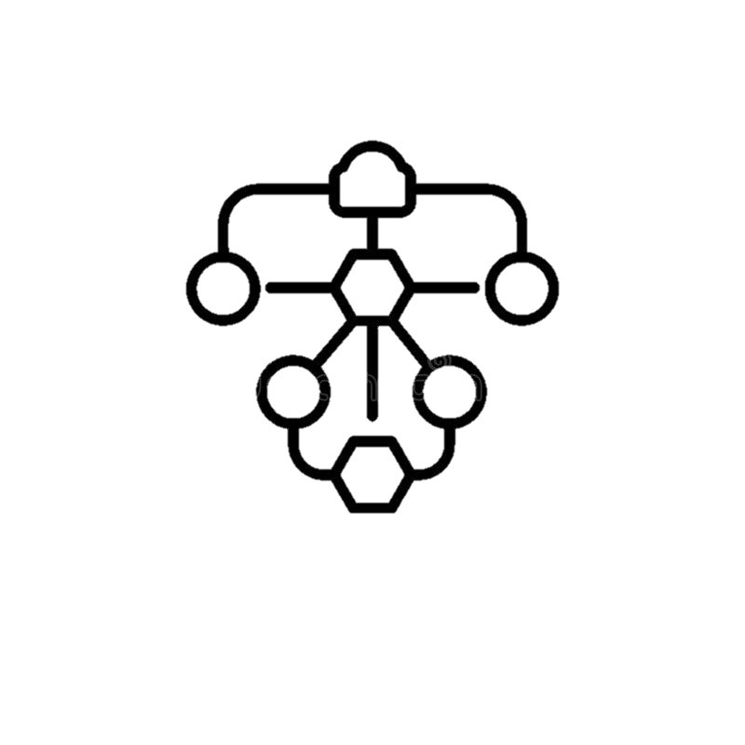





Completed tasks
PyCharm software for project development
Flowcharts & Designs for project structure and layout
GitHub for sharing code between team members
My Lab Programming for learning Python
LSEPI & QA Document
Trello Board for task assigning and work organisation
Gantt Chart for task tracking and time management
Notes:
Brendon

Slide 5
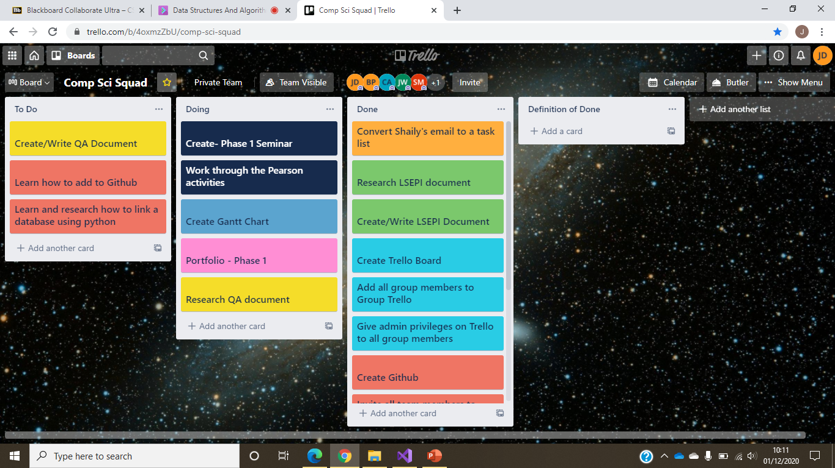
Using a trello board has increased the productivity within the team
We have divided out tasks into 3 columns (to do, doing & done)
All team members have admin privileges, therefore we can create and assign tasks ourselves
trello has enabled us to monitor each team members activity
After a member has finished a task, they can move the associated trello card to the done column and upload their work for the rest of the group
Notes:
Saidhbh

Slide 6

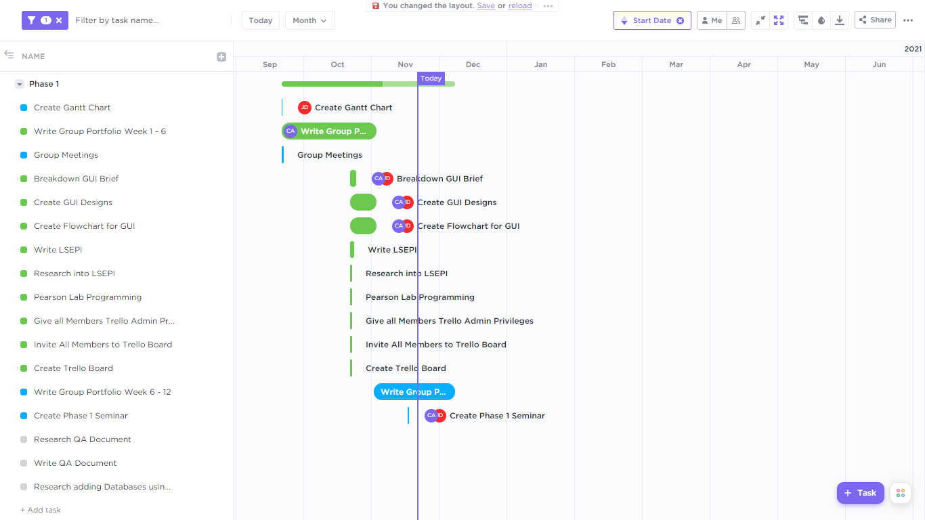
Our Gantt chart has proven useful for the planning of our project
It helped us assess how long our project should take and plan the order in which each task should be completed
It was also useful in managing the dependencies between tasks, indicating when a task should begin or end in relation to other tasks
It provided an easy way to assign tasks to each team member and keep track of everyone's progress
Notes:
Jack

Slide 7
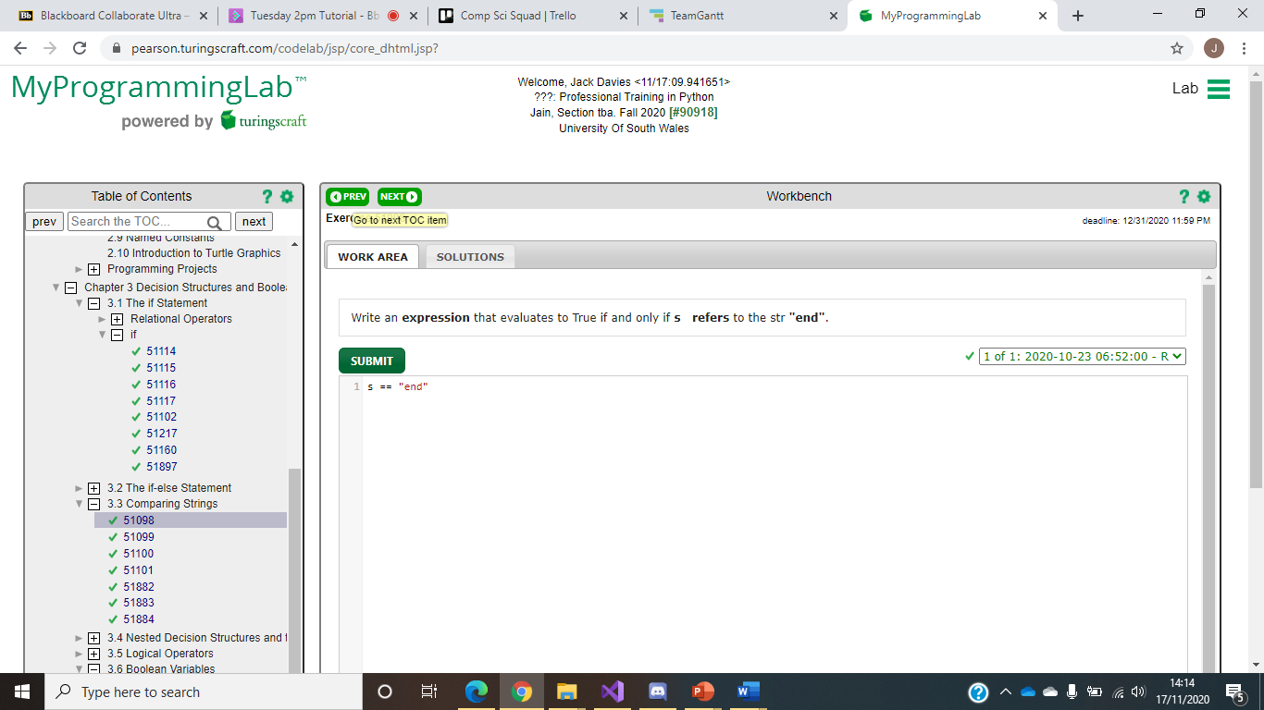
This tool is used to enhance our understanding of Python
It Provides multiple exercises that each target a certain aspect of Python, allowing us to practice and develop our python programming skills
Notes:
Jack

Slide 8
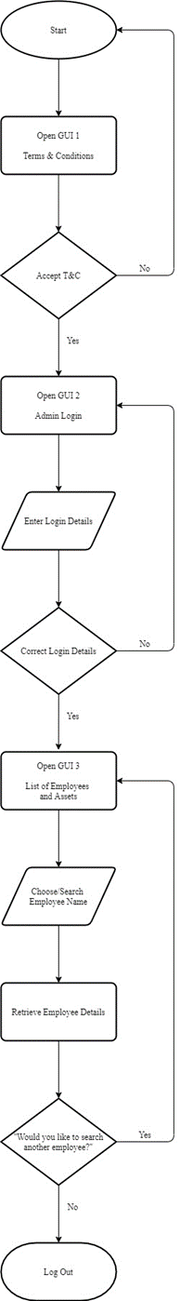
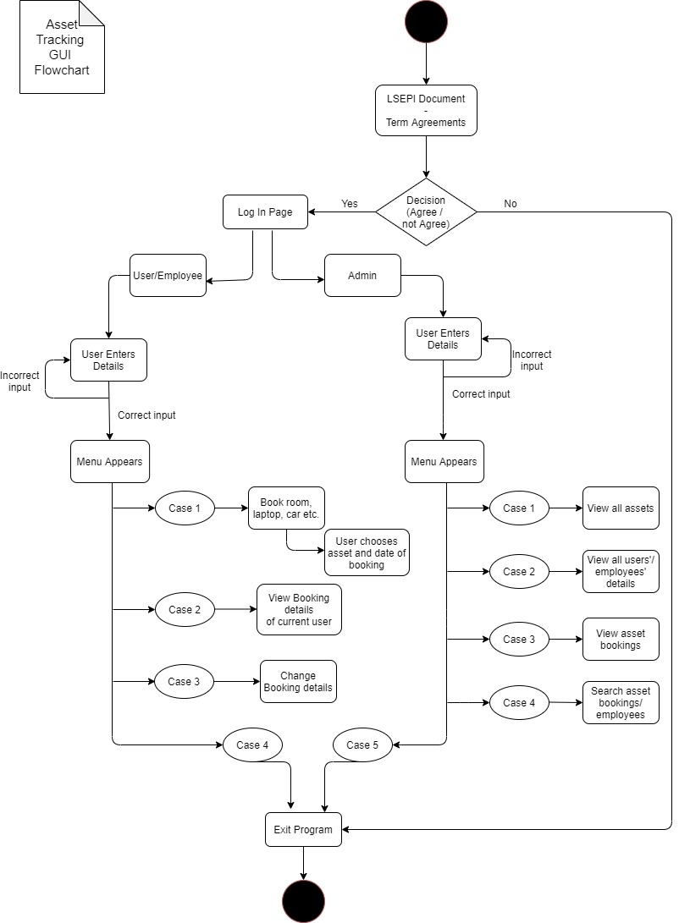
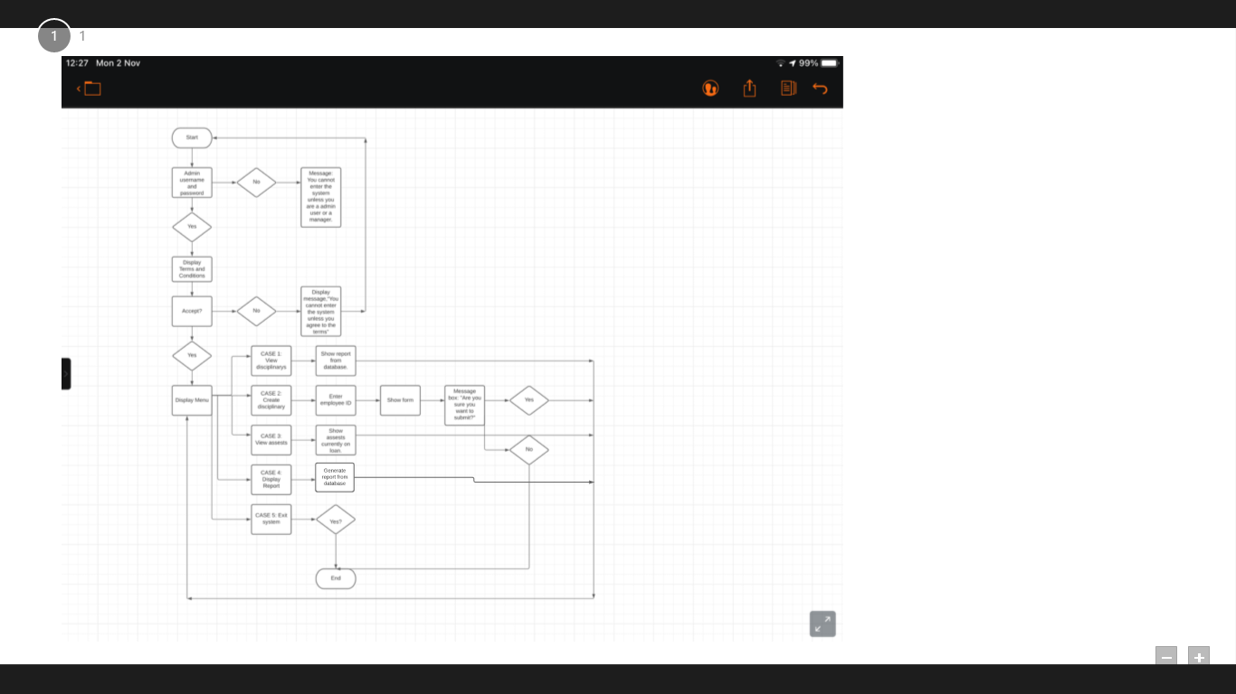
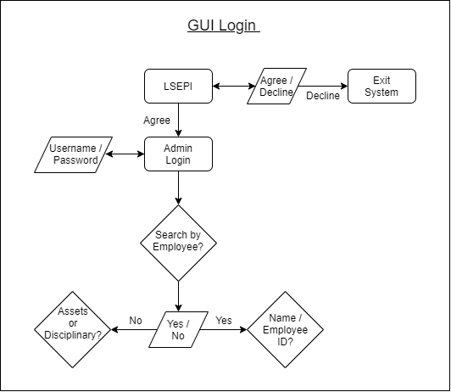
Flowcharts
Each team member has produced a flowchart outlining the structure of our GUI project
This helped brainstorm ideas which lead to creating a more structured and complete design
Notes:
Chloe

Slide 9
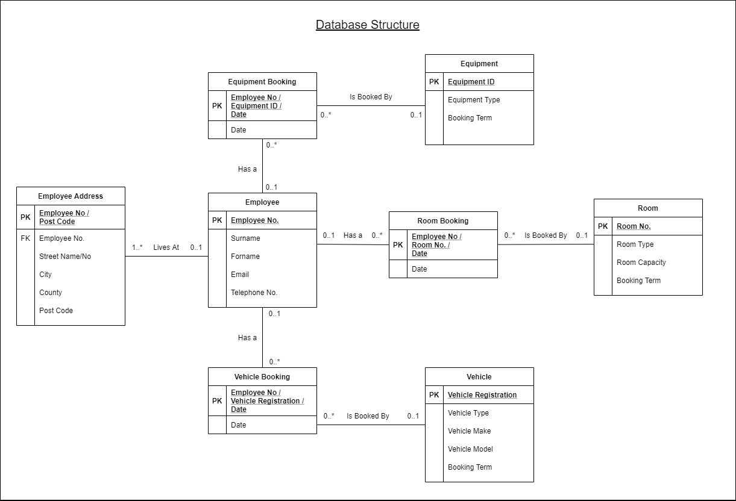
ERD
Saidhbh produced an ERD outlining the possible class structure of our project
This aids in the development of the project as we have a clearer idea on how to start our programming
Notes:
Jenni

Slide 10
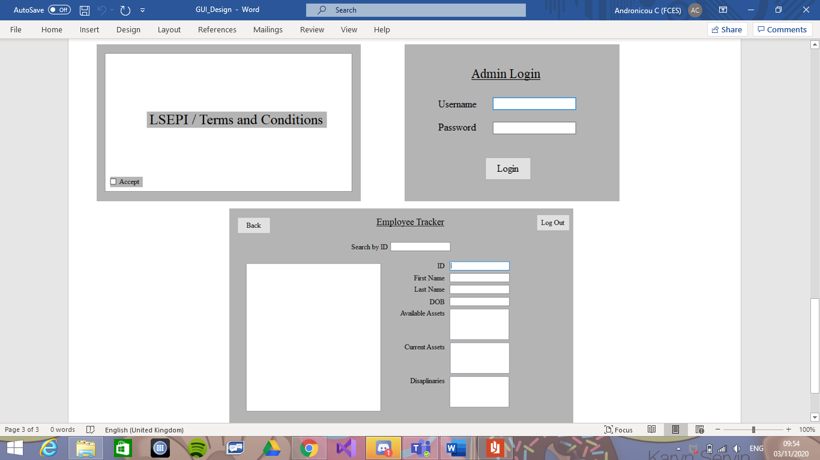
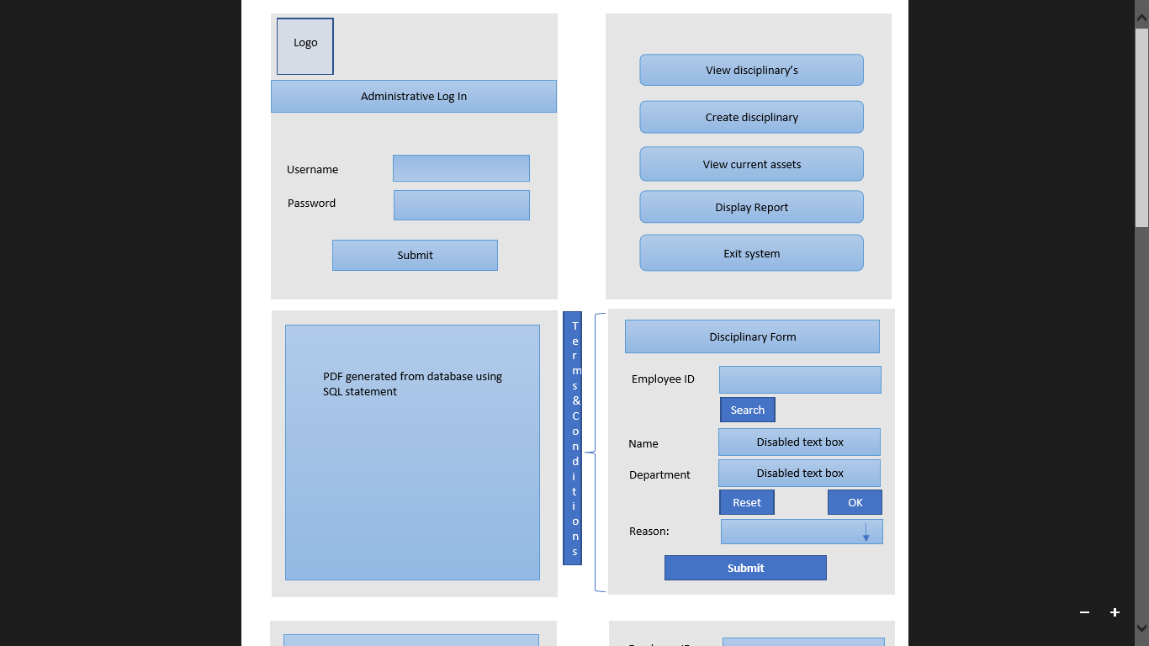
GUI Design
By creating a design in visual studio, we now have a visualised idea of how we want to implement this project in python
This early design was developed based on the flowcharts and erd that were created
Notes:
Jack

Slide 11
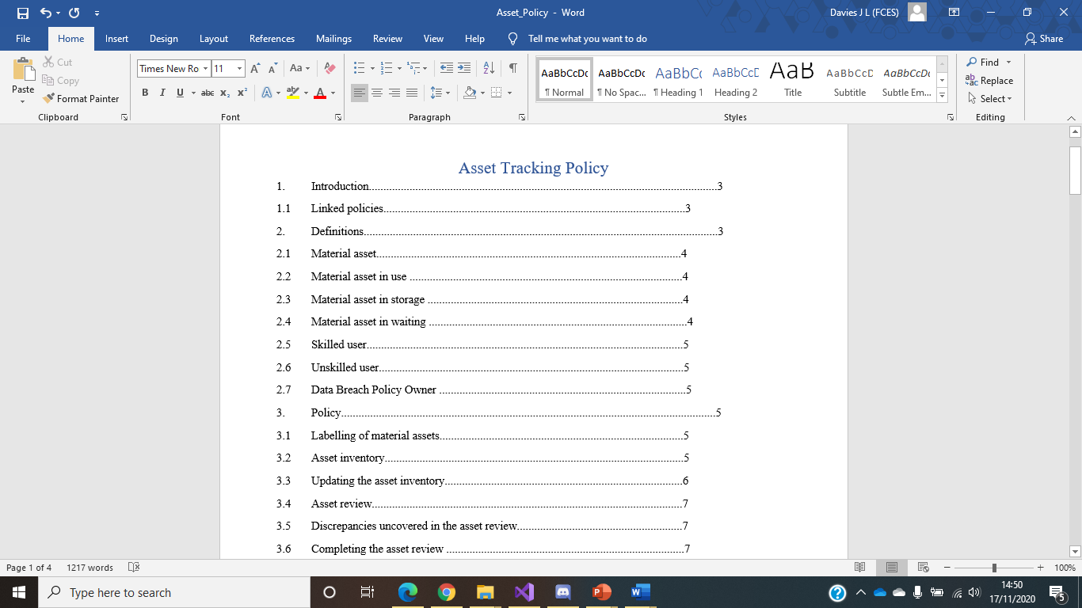
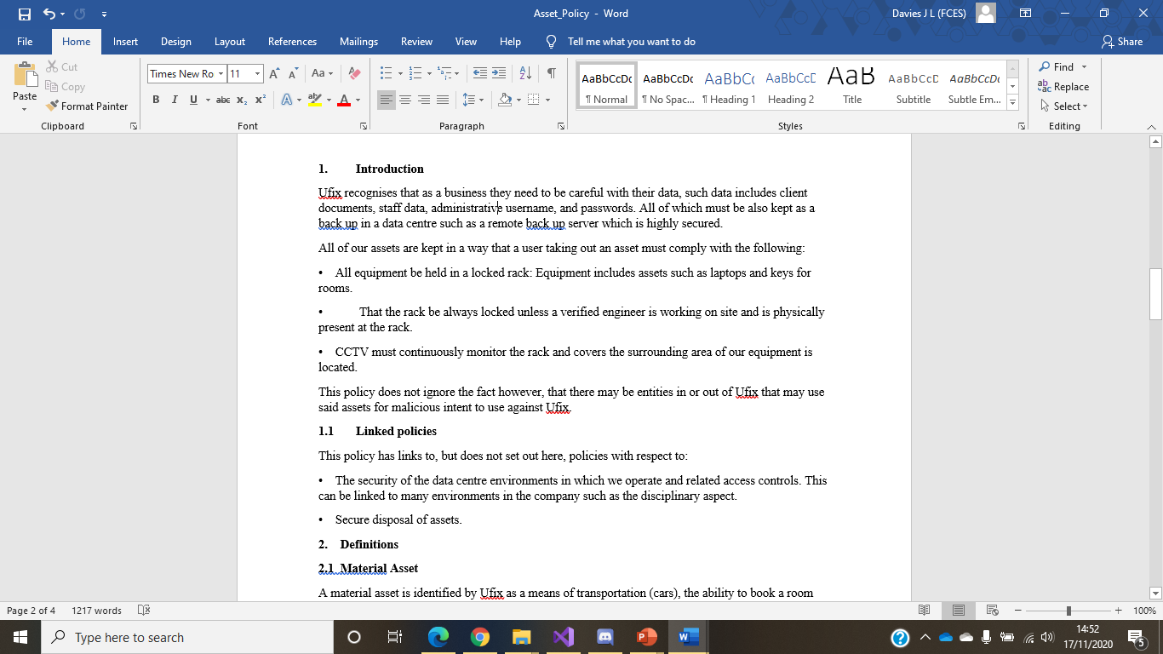
LSEPI document
The lsepi document was created to put at the start of program
It informs the user on the legal, social, ethical and professional issues ensuring the privacy and security of each user
The user is encouraged to read and accept the terms & conditions before continuing
Notes:
Jenni

Slide 12

Quality assurance
By all team members creating flowcharts and design diagrams, different ideas are strung together that others might not of thought of and therefore a more absolute design is produced of higher quality.
By meeting as a group an average of twice week, any issues are addressed promptly and therefore do not affect the quality of our project or set us back with our work.
Our collaboration software (i.e. Trello, Gantt chart, GitHub) enable us to maintain our work at high standard as everything is well organised and time tracked so hat we know who is doing what and when it should be completed.
Notes:
Saidhbh

Slide 13
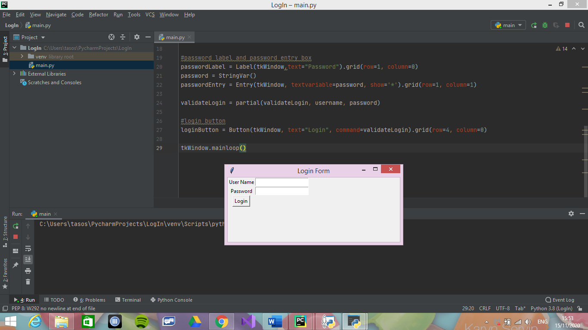
Pycharm
Some team members tried out PyCharm with TKinter and created some brief GUIs for our project
Anything created was a mock up and was just for practise for us to get used to working with the software
Notes:
Chloe

Slide 14

SQLite is a library that implements a database engine
It will be used in association with PyCharm so that we can create our database and then link it to our GUI project
It stores all user data which is accessed and edited through the program
Notes:
Brendon

Slide 15

Team Reflection
What did not go so well
We had a few issues at the beginning on the understanding of our topic but since clarifying everything with our lecturer, everything has been going well.
What went well
As a team we work very well together and are constantly communicating with one another, providing updates on ongoing tasks or highlighting any problems that might come up so they can be resolved. Therefore, as a result of our good team efforts and communication, there have not been any problems.
All tasks that have been completed so far, have been done so without any major issues and anything that was unclear was resolved in our team meetings.
What did we learn
how to work better as a team by setting up various software such as Trello, so we can be more organised
How to code in Python through My Lab Programming exercises
How to structure and create LSEPI and QA documents and understanding their importance in our project
How to share ideas through flowcharts and designs and be able to successfully put them together and create a more complete design for our project
How to adapt working as a team through online meetings
Notes:
Saidhbh

Slide 16
Team Goals
Go over our GUI design for finalisation
Start implementing our design in PyCharm
Put GitHub to use so we can start using it as a team to share code
Use GitHub to be able to communicate with other teams on our projects
Maintain our good Team communication so we can complete the project with ease
Notes:
Chloe

